Slide 1
FUNDAMENTALS OF SOFTWARE PROJECT MANAGEMENT
Cost Benefit Analysis
Week - 13

Slide 2
Main topics to be covered
The business case for a project
Project evaluation
  Cost benefit analysis
  Cash flow forecasting
Benefits management

Slide 3
The business case
Feasibility studies can also act as a ‘business case’
Provides a justification for starting the project
Should show that the benefits of the project will exceed development, implementation and operational costs
Needs to take account of business risks
Notes:
See page 22
It is worth recalling the difference between project success (the project is successfully completed) and business risks (the new product or system successfully established by the project goes on to generate benefits for the organization).
Ultimately, the business case serves as a decision-making tool for key stakeholders, such as executives, investors, and project sponsors. By presenting a comprehensive analysis of the project's feasibility, costs, benefits, and risks, the business case enables stakeholders to make informed decisions about resource allocation and project prioritization.

Slide 4
Contents of a business case
Introduction and background to the proposal
  Describe current environment of proposed project
The proposed Project
  Brief outline of proposed project like estimated demand for product.
The Market
  estimated demand for product.
Organizational and Operational Infrastructure
  How organization infrastructure will be affected by the proposed project

Slide 5
Contents of a business case Cont.
The Benefits
  in term of financial values
Outline Implementation Plan
  Which project activates can be outsourced and which are best to kept in-house
Costs
The Financial Case
  Information on income and cost can be analyzed . Used evaluation techniques
Risks
Management Plan

Slide 6
Project Evaluation
Objectives
  Select Project against STRATEGIC, TECHNICAL and ECONOMIC criteria.
  Use Cost Benefit Techniques to choose a project among other projects proposals.
  Evaluate risks and strategies to minimize potential costs.
Cost: Development, Setup, Operational
Benefits: Direct, Assessable Indirect, Intangible
Notes:
By systematically evaluating projects against strategic, technical, and economic criteria, using cost-benefit techniques, and assessing risks, organizations can make informed decisions about which projects to pursue and allocate resources effectively to maximize value and minimize potential costs.

Slide 7
Project Evaluation - Why
Want to decide whether a project can proceed before it is too late
Want to decide which of the several alternative projects has a better success rate

Slide 8
Project Evaluation–Who and When
Who
  Senior management
  Project manager/coordinator
  Team leader
When
  Usually at the beginning of the project

Slide 9
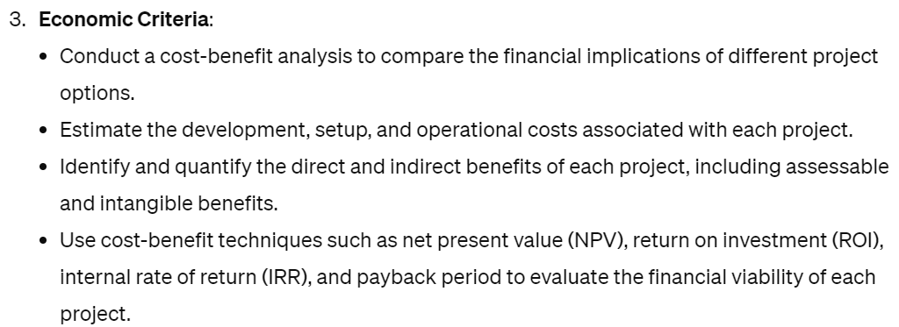
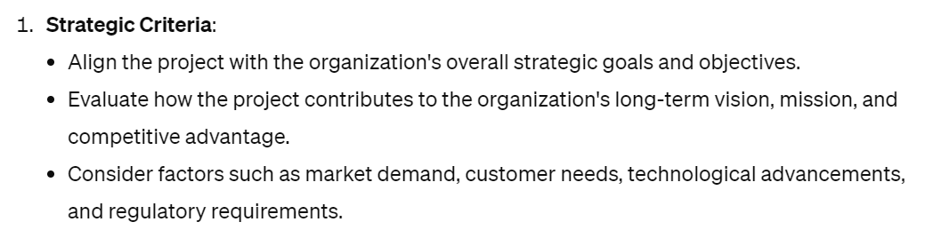
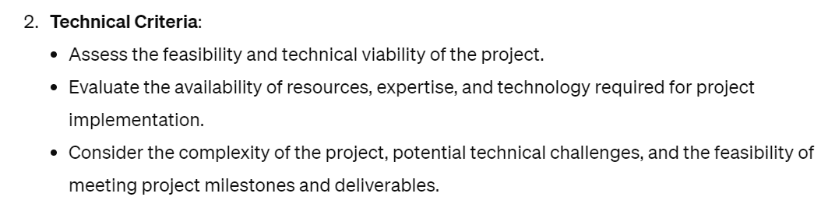
Project Evaluation - What
Strategic assessment
Technical assessment
Economic assessment

Slide 10
Project Evaluation - How
Cost-benefit analysis
Cash flow forecasting
Cost-benefit evaluation techniques
Risk analysis

Slide 11
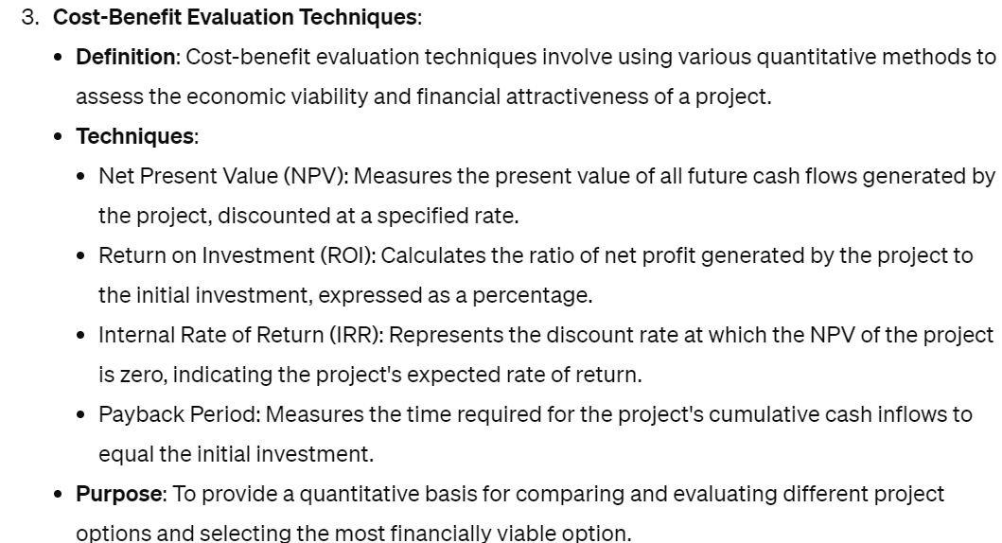
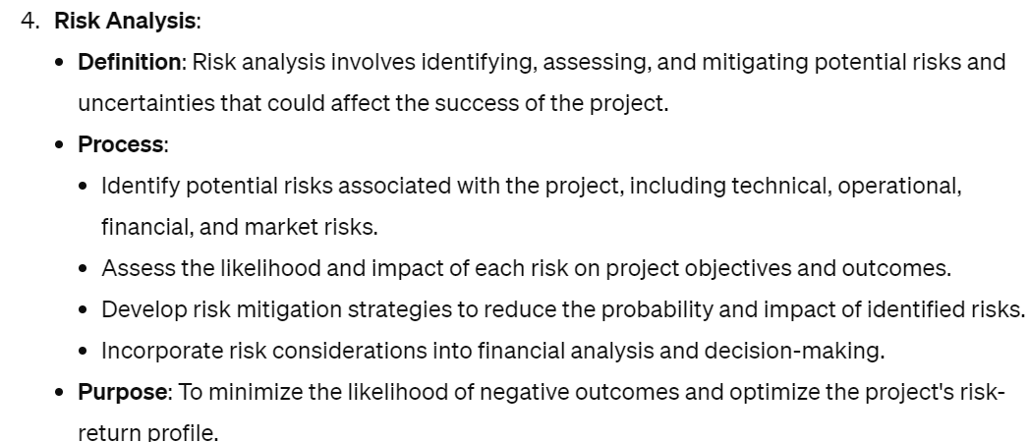
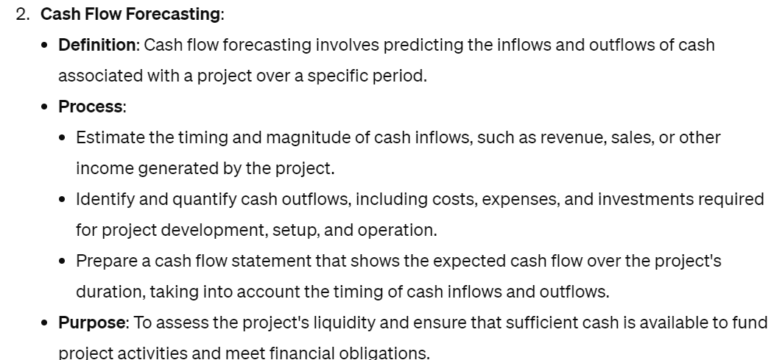
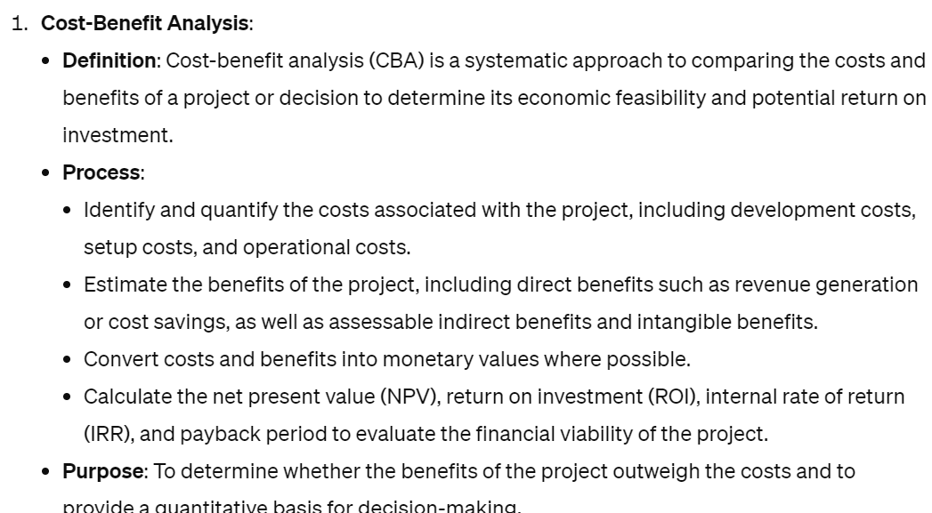

Slide 12
Strategic Assessment
Used to assess whether a project fits in the long-term goal of the organization
Usually carried out by senior management
Needs a strategic plan that clearly defines the objectives of the organization
Evaluates individual projects against the strategic plan or the overall business objectives

Slide 13
Evaluation of individual projects
Technical Assessment
  Evaluate required functionality against hardware and software
  The cost of technology adopted must be taken into account in the cost benefit analysis

Slide 14
Economic Assessment
Why?
Consider whether the project is the best among other options
Prioritise the projects so that the resources can be allocated effectively if several projects are underway
Notes:
A common way is to compare the expected costs of development and operation of the system with the benefits of having it in production

Slide 15
Economic Assessment (cont’d)
How?
Cost-benefit analysis
Cash flow forecasting
Various cost-benefit evaluation techniques
  NPV and IRR
Notes:
Cost-benefit analysis is to compare the estimated costs of development and operation of a system with the estimated benefits of putting the system in place.
Cash flow forecasting is …
Why need Cash flow forecasting? It is because the excess of benefits over costs is not sufficient to justify the implementation of a proposed project.

Slide 16
Cost benefit analysis (CBA)
This relates to an individual project. You need to:
Identify all the costs which could be:
  Development costs
  Set-up
  Operational costs
Identify the value of benefits
Check benefits are greater than costs
Notes:
Section 2.4 of the text expands this material.
Exercise 2.1 requires students to identify the potential costs and benefits of the Brightmouth College payroll application.

Slide 17
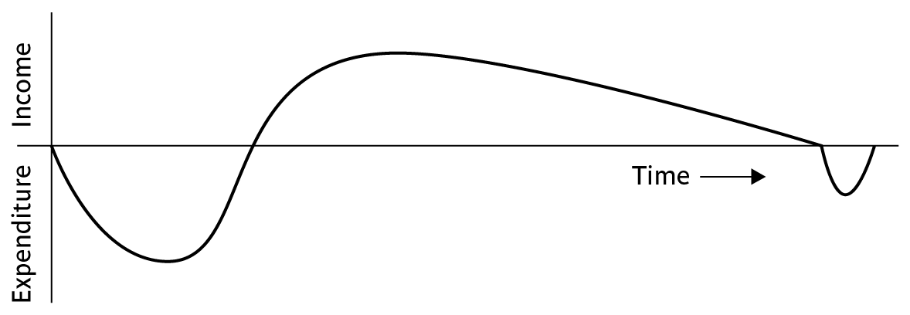
Product/system life cycle cash flows
The timing of costs and income for a product of system needs to be estimated.
The development of the project will incur costs.
When the system or product is released it will generate income that gradually pays off costs
Some costs may relate to decommissioning – think of demolishing a nuclear power station.
Notes:
Need to spend money at first (e.g. staff salary, employment cost, hardware and software costs) no matter where the money comes from
e.g. resources from company, or money from the bank
If the money is from bank, you need to calculate the interest as well.

Slide 18
EA– Cash Flow Forecasting
Year Project 1 Project 2 |  |  |  | Project 3 | Project 4
0 |  | -100,000 | -1,000,000 | -100,000 | -120,000
1 |  | 10,000 | 200,000 | 30,000 | 30,000
2 |  | 10,000 | 200,000 | 30,000 | 30,000
3 |  | 10,000 | 200,000 | 30,000 | 30,000
4 |  | 20,000 | 200,000 | 30,000 | 30,000
5 |  | 100,000 | 300,000 | 30,000 | 75,000
Net | Profit | 50,000 | 100,000 | 50,000 | 75,000
Problem with Cashflow Forecasting
Need to forecast the expenditure and the income
Accurate forecast is not easy
Need to revise the forecast from time to time
Notes:
This is a table of cash flow forecasts for different projects. The table shows the expected net cash inflow (positive number) or outflow (negative number) for each project over a five-year period.
Cash flow forecasting is an important part of financial planning. It helps businesses estimate how much cash they will have on hand in the future. This information can be used to make decisions about budgeting, investing, and borrowing.

Slide 19
Cost-benefit evaluation techniques
Net Profit
  Difference b/w total cost and total income
Payback Period
  Time taken to pay back the initial investment
Return on Investment
  Compare the net profitability to the investment required
Net Present value
  Used in capital budgeting to analyze the profitability of an investment or project.
  NPV measures the total amount by which an investment is expected to increase based on the present value of its potential cash flows and initial cost.
Internal Rate of return

Slide 20
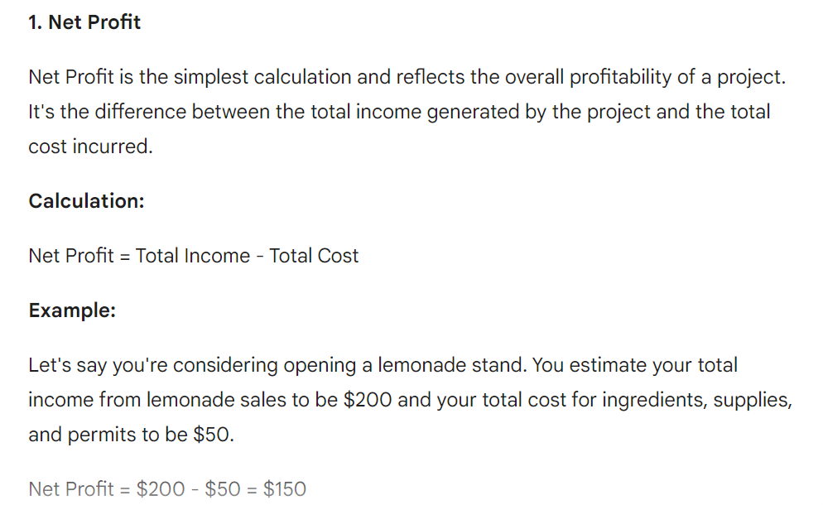

Slide 21
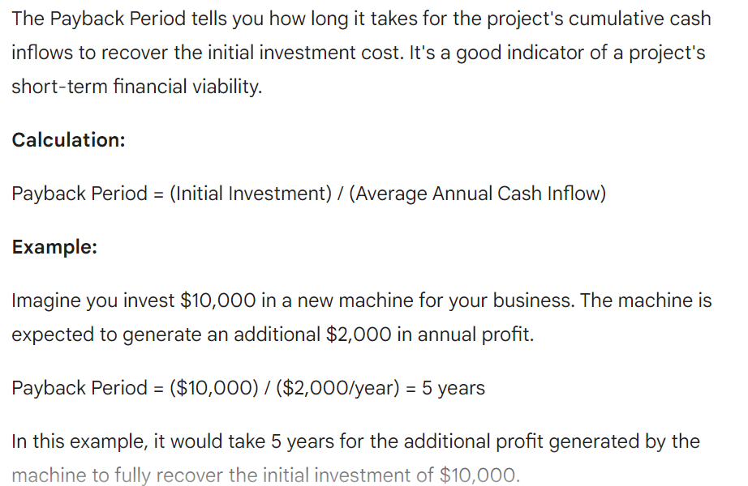
Payback Period

Slide 22
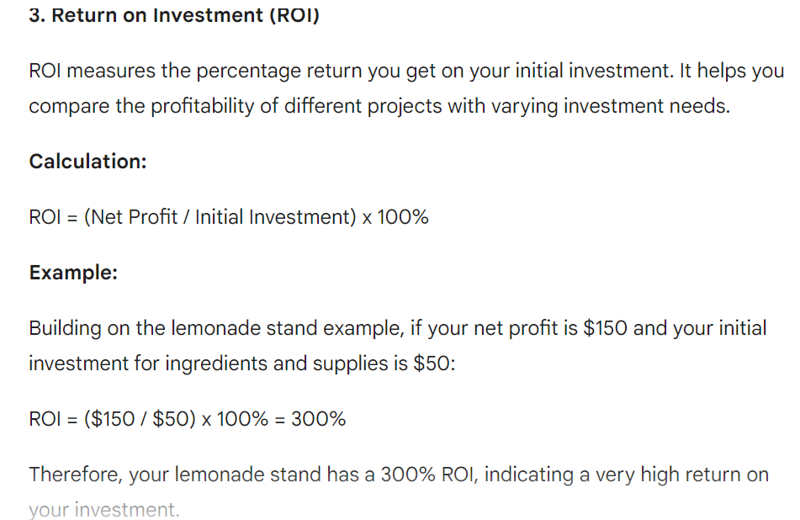

Slide 23
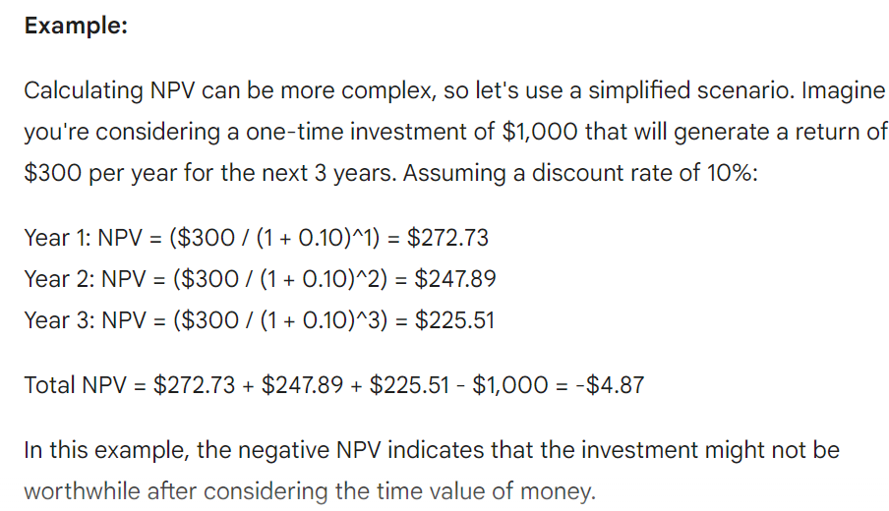
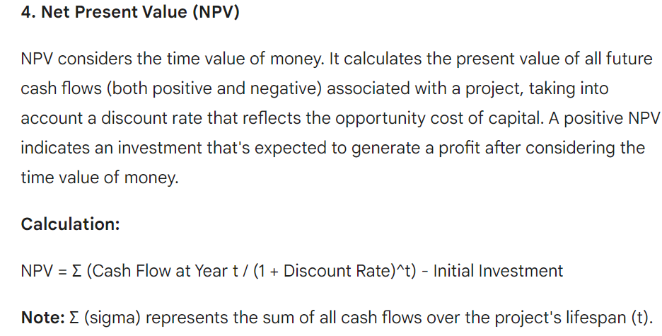

Slide 24
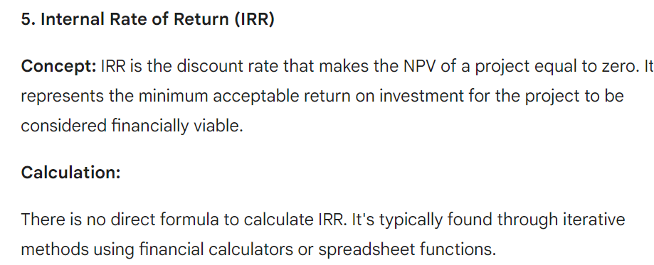

Slide 25
Net profit
Year | Cash-flow
0 | -100,000
1 | 10,000
2 | 10,000
3 | 10,000
4 | 20,000
5 | 100,000
Net profit | 50,000
‘Year 0’ represents all the costs before system is operation
‘Cash-flow’ is value of income less outgoing
Net profit value of all the cash-flows for the lifetime of the application

Slide 26
Pay back period
This is the time it takes to start generating a surplus of income over outgoings. What would it be below?
Year | Cash-flow | Accumulated
0 | -100,000 | -100,000
1 | 10,000 | -90,000
2 | 10,000 | -80,000
3 | 10,000 | -70,000
4 | 20,000 | -50,000
5 | 100,000 | 50,000
Notes:
The payback period would be about 4.5 years. This can be calculated as the last year in which the accumulated cash flow was negative + (absolute accumulated cash flow at the end of that year / cash-flow for the next year) e.g. year 4 + (50,000/100,000). This assumes that the flow of cash is constant throughout the year in question e.g. £100,000/12 or £8,333 a month in year 5
Exercise 2.3. in the text is relevant here.

Slide 27
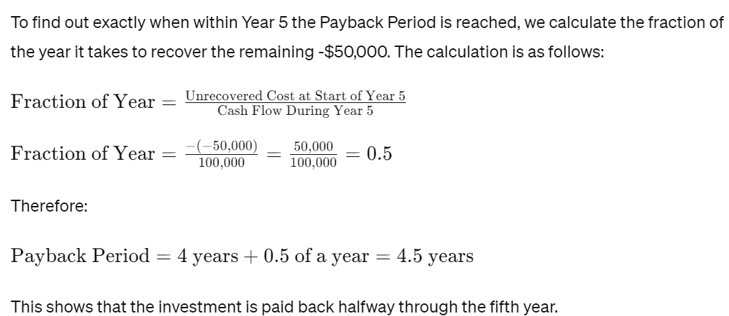
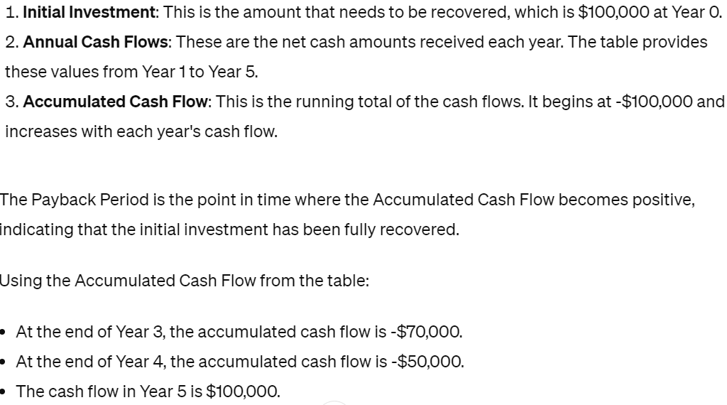

Slide 28
Return on investment (ROI)
Average annual profit
Total investment
X 100
ROI =
In the previous example
average annual profit
= 50,000/5
= 10,000
ROI = 10,000/100,000 X 100 = 10%
ROI is also known as:
Accounting rate of return (ARR)

Slide 29
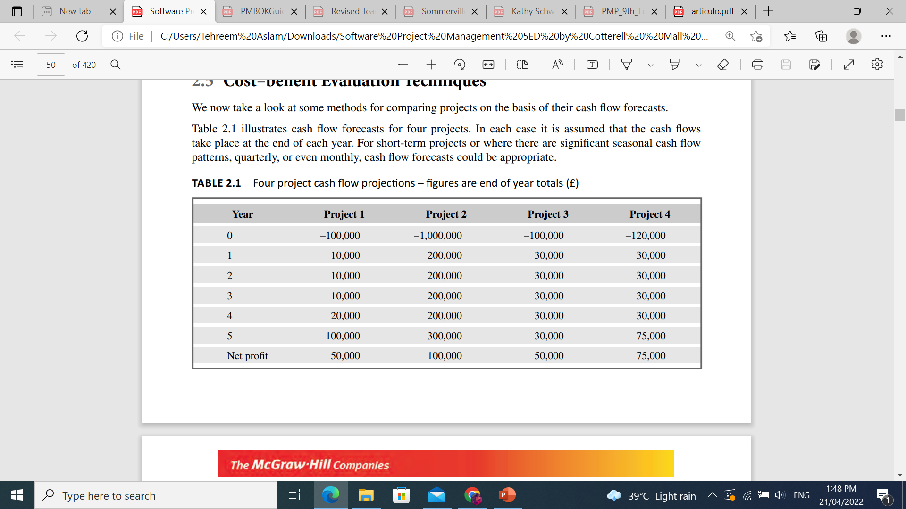
Calculate Payback period and ROI

Slide 30
Calculate Pay back period and ROI
Calculating payback periods
The payback periods for each of the projects will occur during the year indicated:
project 1, year 5;
project 2, year 5;
project 3, year 4
project 4, at the end of year 4.
We would therefore favor project 3 or 4 over the other two. Note that, in reality, with relatively short-term projects such as these we would produce a monthly (or at least quarterly) cash flow forecast and it is therefore likely that project 3 would be seen more clearly to have a shorter payback period than project 4

Slide 31
Calculate Pay back period and ROI
The return on investments for each of the projects is –
  project 1: 10%,
  project 2: 2%,
  project 3: 10%
  project 4: 12.5%.
Project 4 therefore stands out as being the most beneficial as it earns the highest return

Slide 32
Net Profit, Payback Period and ROI
Technique | Advantages | Disadvantages
Net Profit | Simple to Use | -Does not show profit relative to size of investment -Ignores the Timing of cash flow
Payback Period | -Simple to calculate, not particular sensitive to small forecasting errors. -Give some idea of cashflow impact | -Ignores any income (or expenditure) after the payback period. -Ignores overall profitability of project
Return on Investment (ROI) | simple and easy to calculate, quite popular | -Ignores the timing of the cash flow. -Potentially very misleading because rate of return bears no relationship with the current interest rates
Notes:
Net profit = Total income – Total costs
Payback period = Time taken to break even or payback initial investment
Return on Investment (ROI): Compares Net profitability to Investment required.

Slide 33
Net present value
Would you rather I gave you £100 today or in 12 months time?
If I gave you £100 now you could put it in savings account and get interest on it.
If the interest rate was 10% how much would I have to invest now to get £100 in a year’s time?
This figure is the net present value of £100 in one year’s time
Notes:
If you invested £91 now you would get £9.10 in interest which would give you £100.10 in 12 months. The interest rate of 10% is used purely to make it easy to do the calculations, not because it is a realistic rate.

Slide 34
Discount factor
Discount factor = 1/(1+r)^{t}
  r is the interest rate (e.g. 10% is 0.10)
  t is the number of years
In the case of 10% rate and one year
Discount factor = 1/(1+0.10) = 0.9091
In the case of 10% rate and two years
Discount factor = 1/(1.10 x 1.10) =0.8264

Slide 35
Applying discount factors
Year | Cash-flow | Discount factor | Discounted cash flow
0 | -100,000 | 1.0000 | -100,000
1 | 10,000 | 0.9091 | 9,091
2 | 10,000 | 0.8264 | 8,264
3 | 10,000 | 0.7513 | 7,513
4 | 20,000 | 0.6830 | 13,660
5 | 100,000 | 0.6209 | 62,090
 |  | NPV | 618
Notes:
NPV is the sum of the discounted cash flows for all the years of the ‘project’ (note that in NPV terms the lifetime of the completed application is included in the ‘project’)
The figure of £618 means that £618 more would be made than if the money were simply invested at 10%. An NPV of £0 would be the same amount of profit as would be generated by investing at 10%.

Slide 36
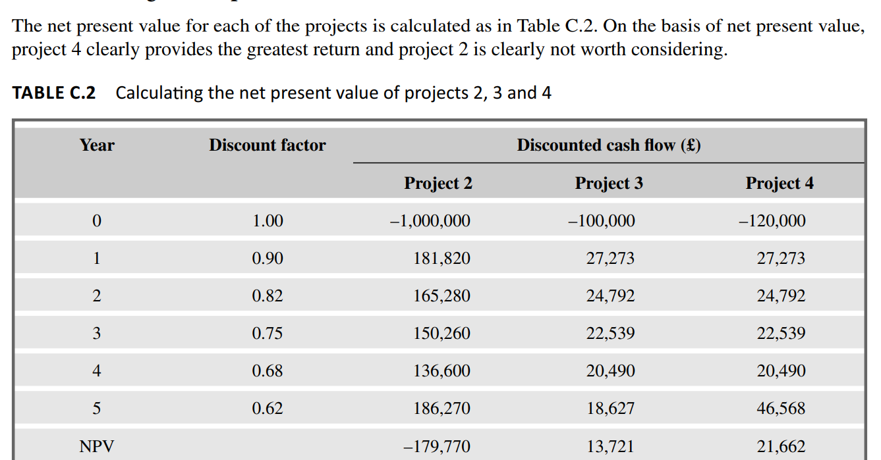
Activity

Slide 37
Cost Benefit Evaluation Techniques - NPV
Year | Cashflow Project 2 | Cashflow Project 3 | Discount Factor (10%) PV = 1/(1+r)^{n} | Discounted Cashflow Project 2 (cash flow * discount factor) | Discounted Cashflow Project 3
0 | -100,000 | -100,000 | 1 | -100,000 | -100,000
1 | 10,000 | 30,000 | 0.9091 | 9091 | 27273
2 | 10,000 | 30,000 | 0.8264 | 8264 | 24792
3 | 10,000 | 30,000 | 0.7513 | 7513 | 22539
4 | 20,000 | 30,000 | 0.683 | 13,660 | 20490
5 | 100,000 | 30,000 | 0.6209 | 62,090 | 18627
Net profit | 50,000 | 50,000
NPV |  |  |  | 618 | 13,721
Though Project 2 and 3 have same initial investment and net profits but significant different in NPV value. This difference in NPV reflects, we must wait longer for the bulk of income.

Slide 38
Cost Benefit Evaluation Techniques - NPV
Technique | Advantages | Disadvantages
Net Present Value | -Takes into account the profitability. -Consider the timings of payments. -Consider economic situation through discount rate. | -Hard to select an appropriate discount rate. -May not be directly comparable with earnings from other investments or the costs of borrowing capital

Slide 39
Internal rate of return
Internal rate of return (IRR) is the discount rate that would produce an NPV of 0 for the project
Can be used to compare different investment opportunities
There is a Microsoft Excel function which can be used to calculate
Notes:
The Excel function in question is =IRR.

